Slide 1

A Computational Biology Framework
Creating a platform for Biomedical Engineers to improve their data mining efficiency

Slide 2
Contents
Project Explanation
Introduction
Research questions
Past Work
Data Mining Seminar
Basic Analysis Data Set
Results Analysis
Project course
Framework lay-out
Focus
A Computational Biology Framework

Slide 3
Project Explanation
Graduation project Tim Beishuizen

Slide 4
Project
Explanation
Introduction
Joint Master project
Computational Biology (BME)
Data Mining (CSE)
Biomedical Data Mining
Data challenges
Target challenges
Tool challenges
Knowledge challenges
Framework creation
Bariatric data set
A Computational Biology Framework

Slide 5
Project
Explanation
Research Questions
What aspects are of importance to include in a framework for Biomedical Engineers for more efficient data analysis?
Sub Questions
Data challenges
Target driven
Tool availability
Tool extension
Knowledge challenges
A Computational Biology Framework

Slide 6
Past work
What did I do already?

Slide 7
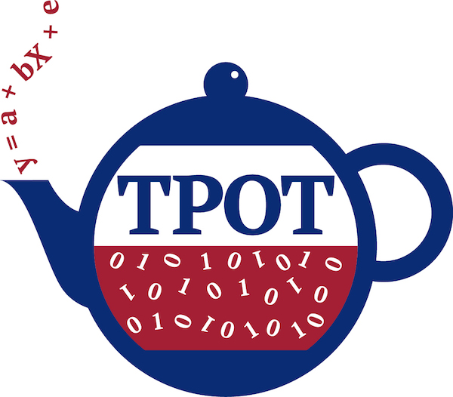

Past work
Data Mining Seminar
TPOT
Optimization tool
Machine learning
Skin disease data set
High dimensionality
Low data volume
Data heterogeneity
Results
Potential
Preprocessing Extensions
A Computational Biology Framework

Slide 8
Past work
Basic Analysis Data Set
Skin disease data set
Feature reduction
Significance extraction
Multicollinearity
Feature clustering
Greedy clustering
Joint biomedical process relation
Testing Improved Results
Random Forests
A Computational Biology Framework

Slide 9
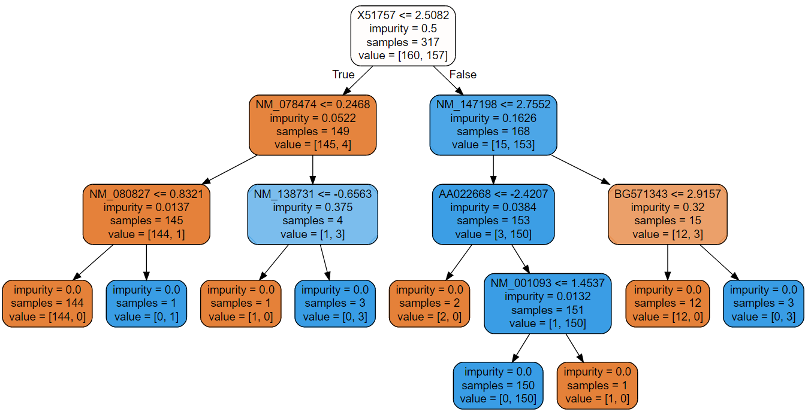
Past work
Results
Feature reduction
From 54675 to 1768
From 0.9 to 0.95 accuracy (random forest)
Clustering
Interesting clusters found
A Computational Biology Framework

Slide 10
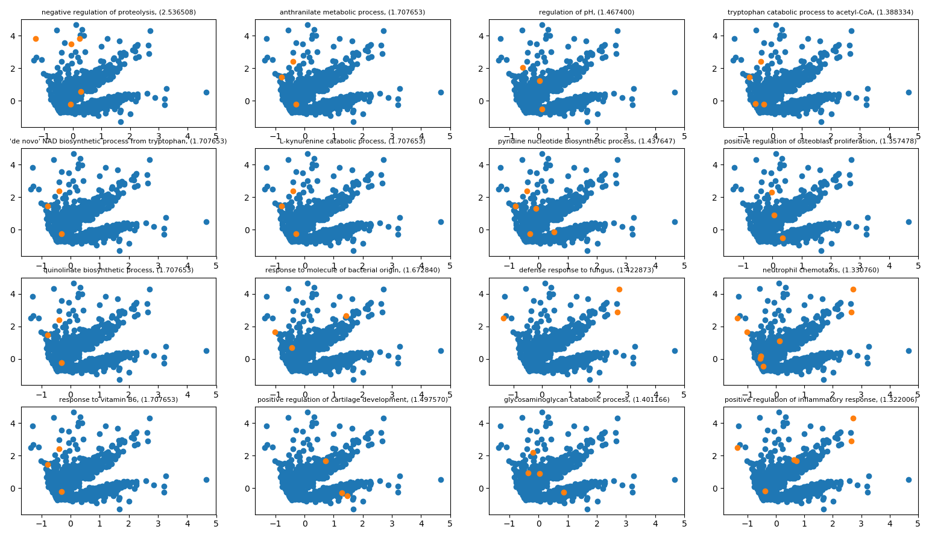
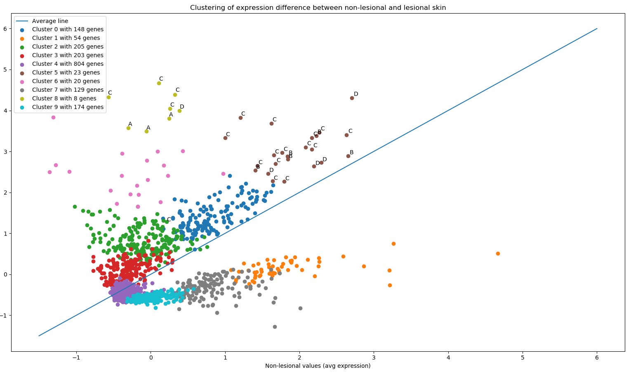

Slide 11
Project Planning
Everything planned for the graduation project

Slide 12
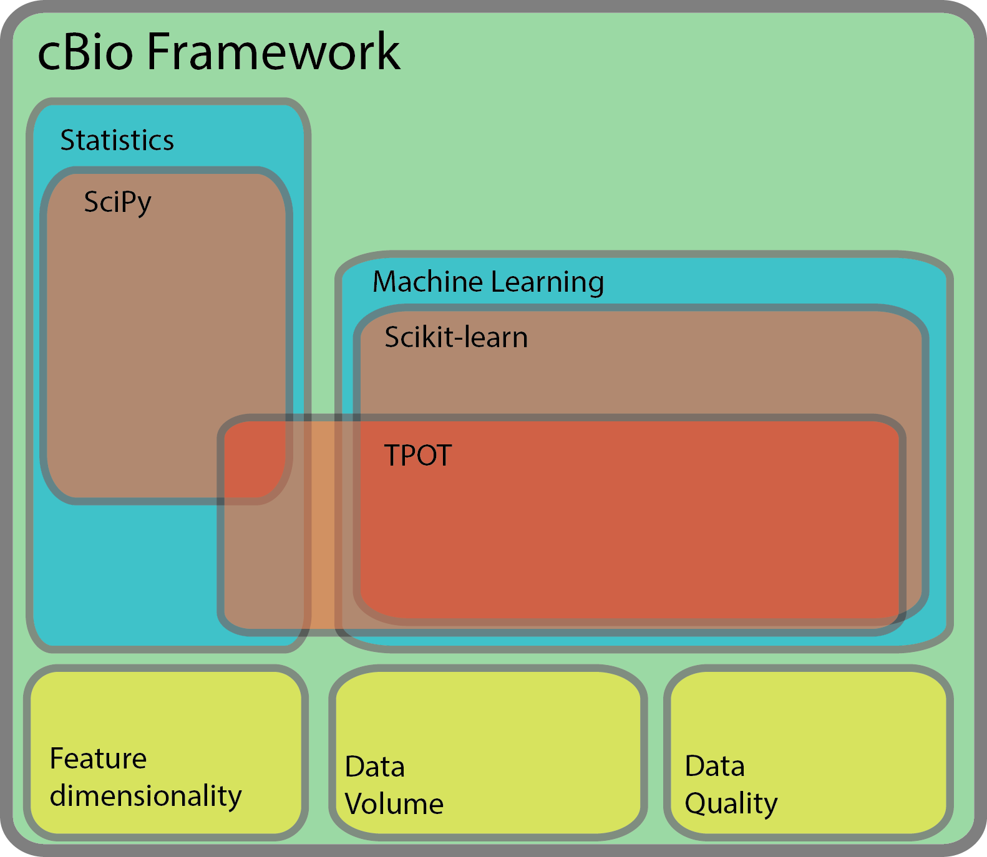
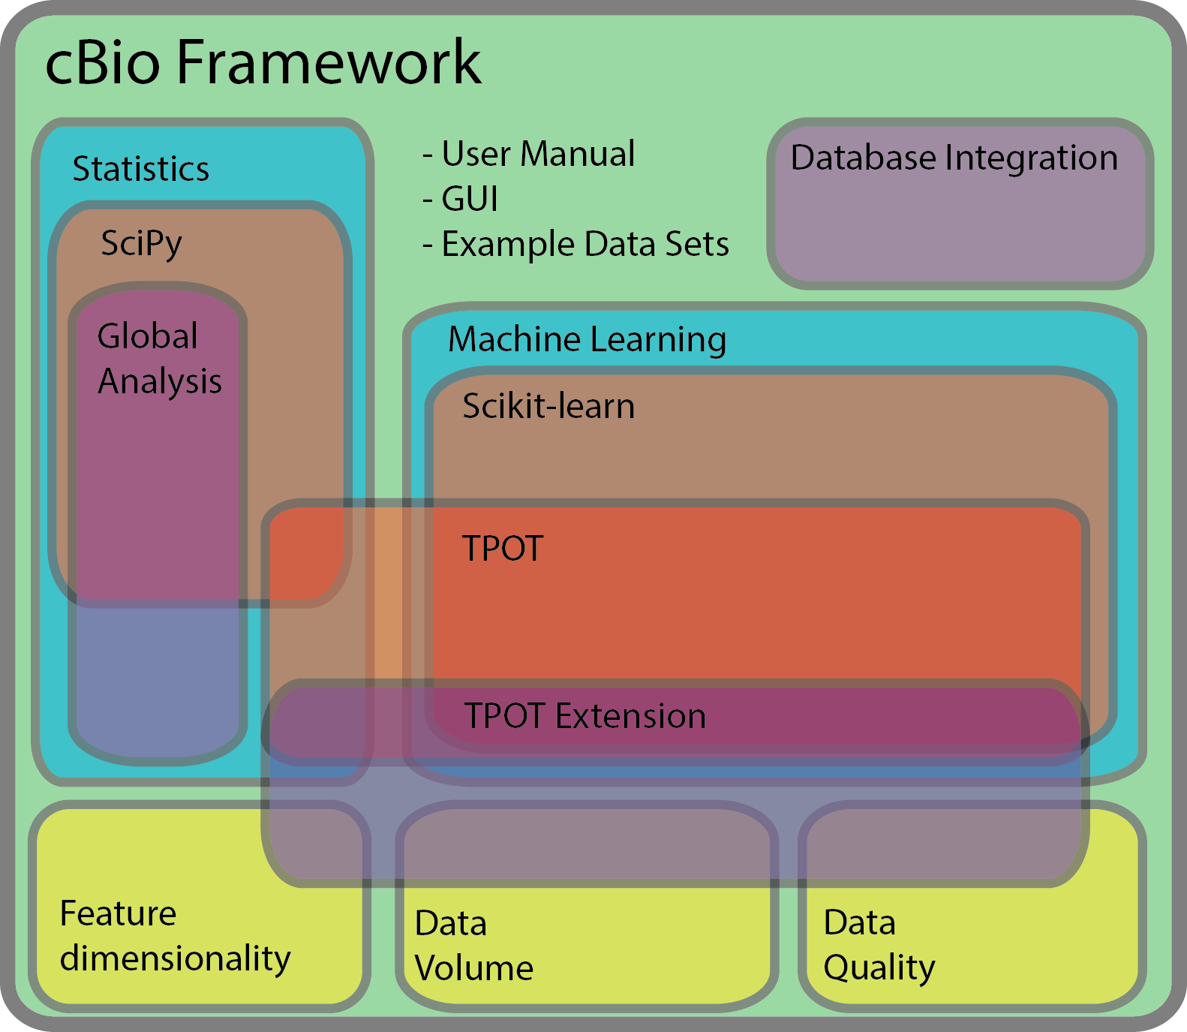
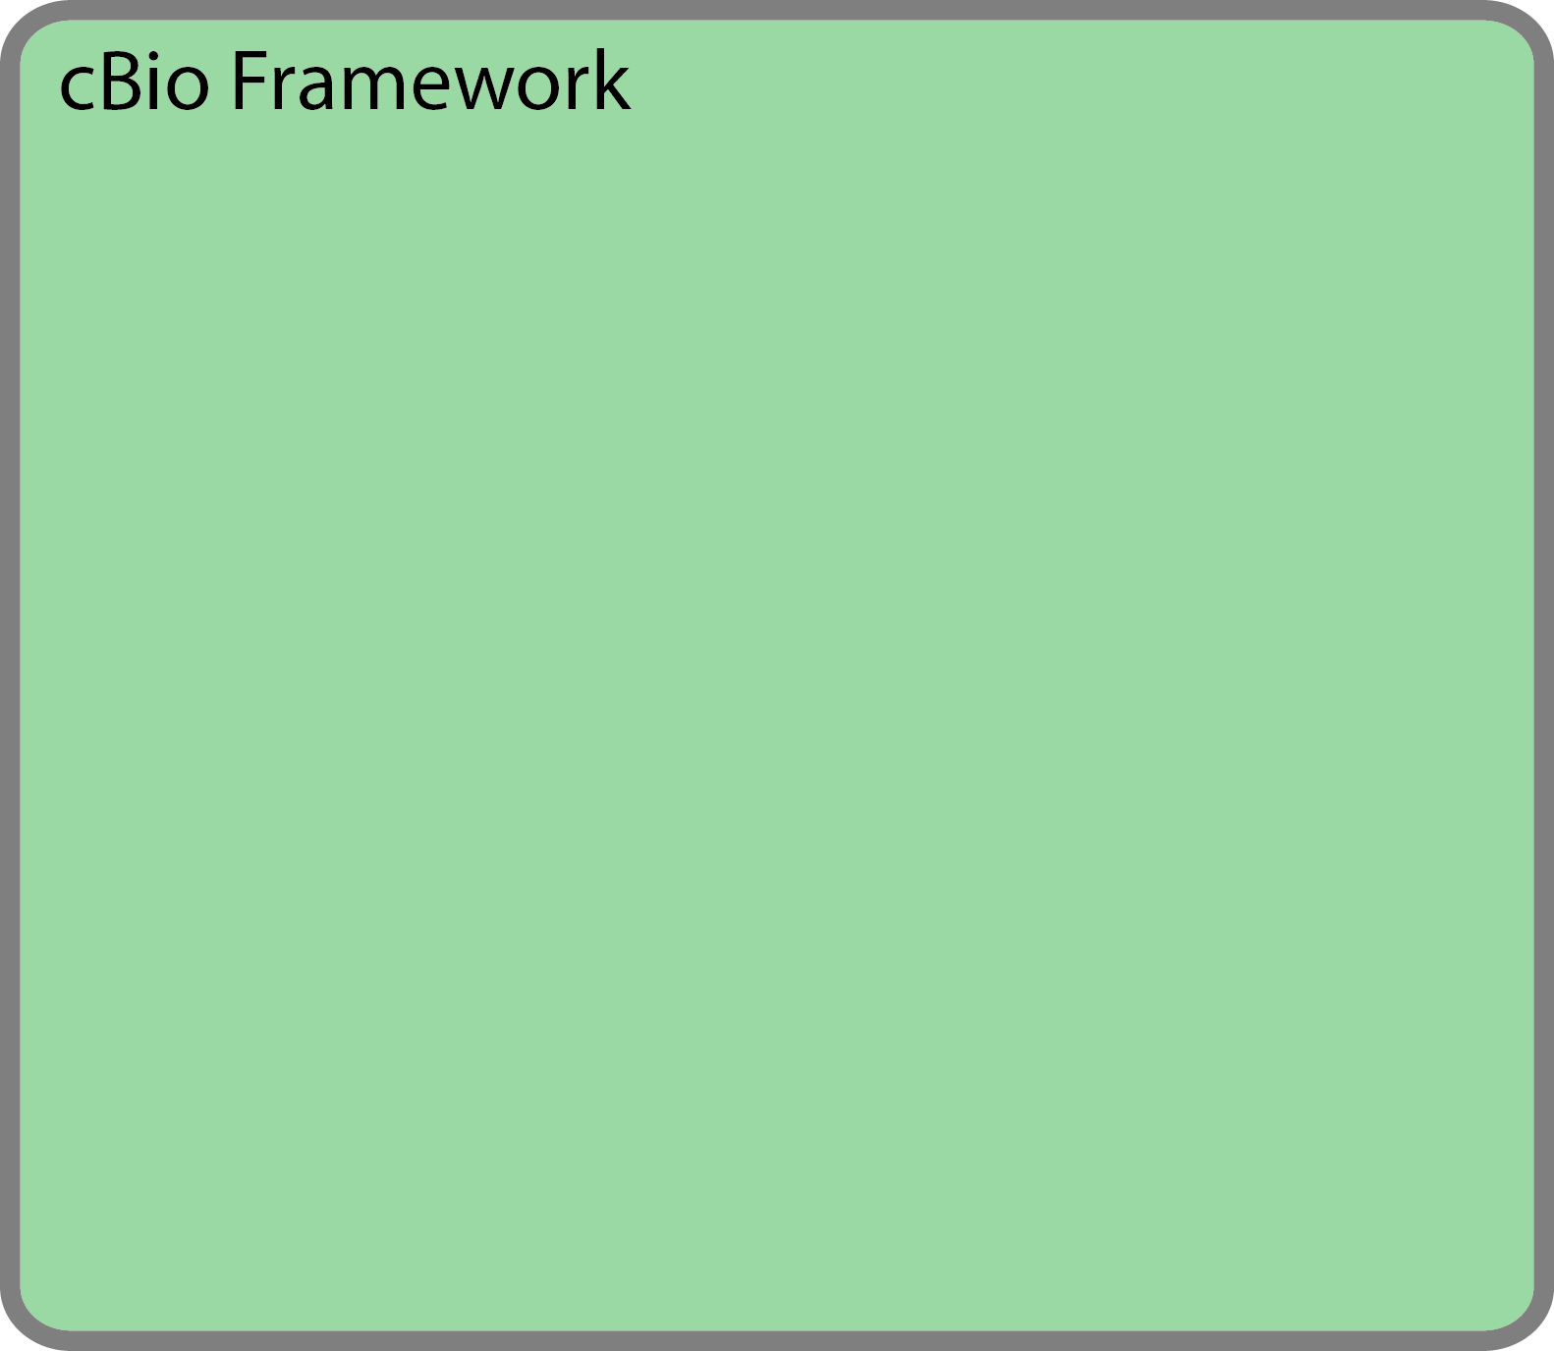
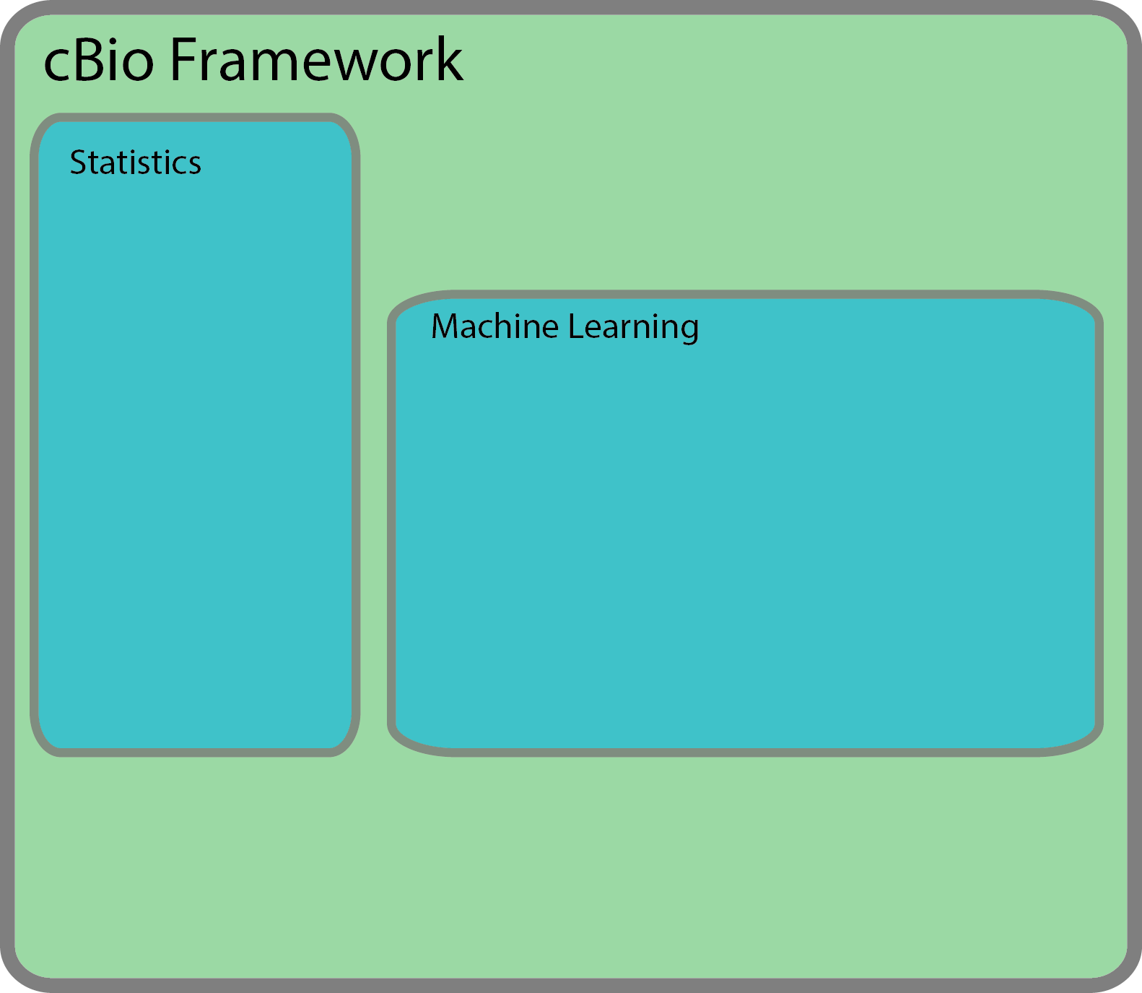
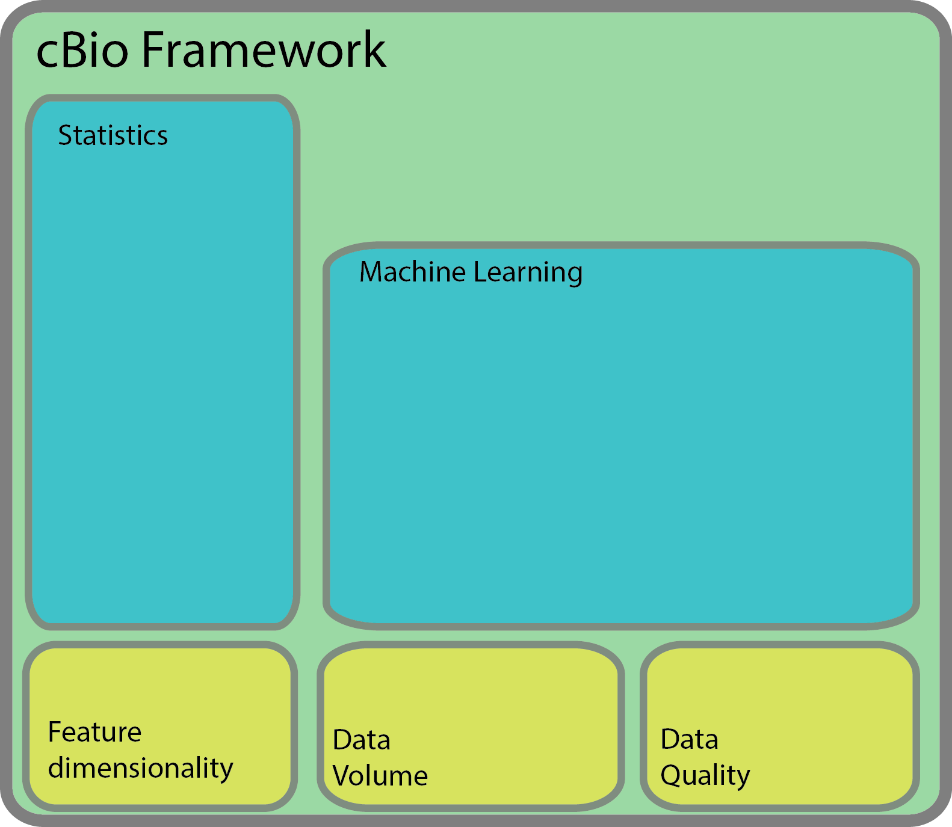
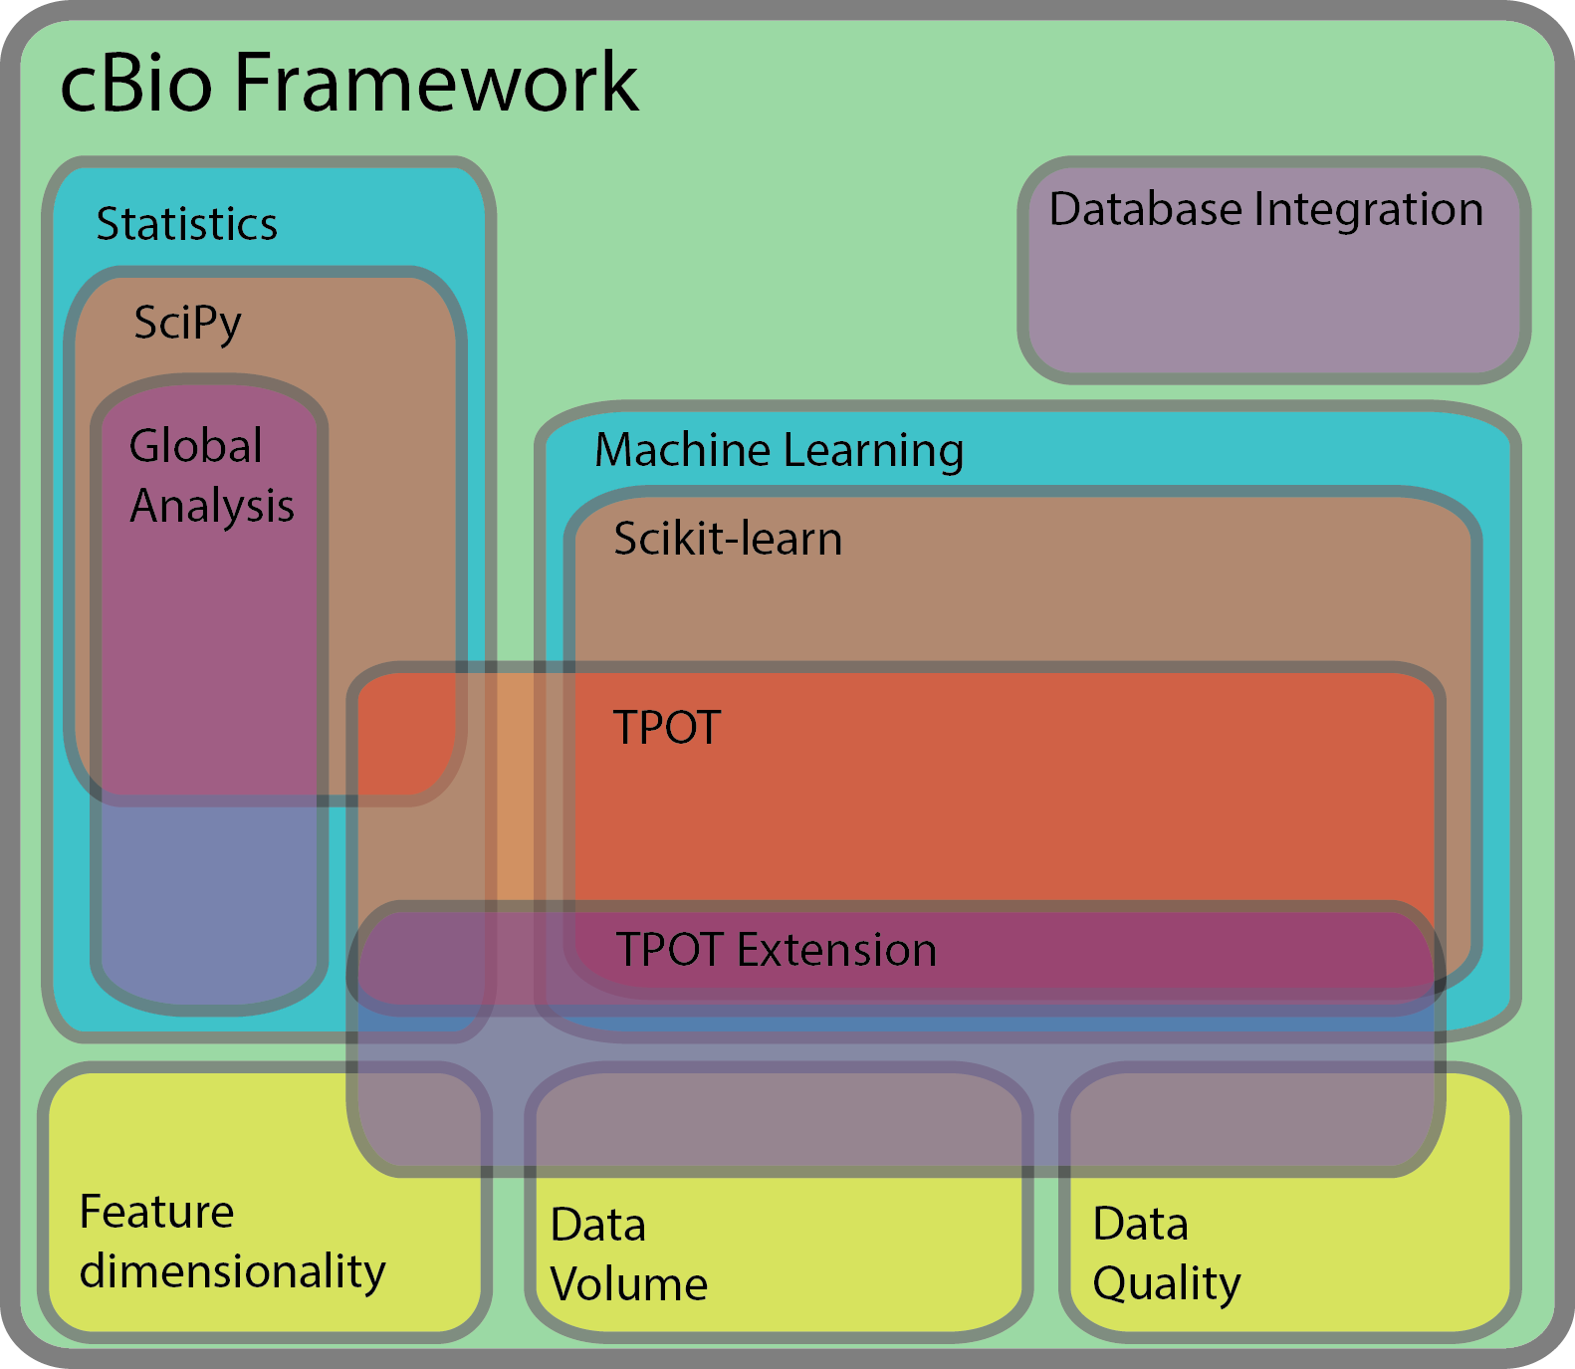
Project
Planning
Framework Layout
A Computational Biology Framework

Slide 13
Project
Planning
Planning
Preprocessing
Feature Dimensionality
Data Volume
Data Quality
TPOT extension
Further extension
Global Analysis
Database Integration
A Computational Biology Framework

